Slide 1
Talk About Violence with pictures
www.kvinnofrid.nu

Slide 2
I'm worried about you and wondering if something has happened?

Slide 4
Do you want to talk about what has happened?

Slide 6
Tell me what happened...

Slide 7
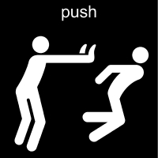
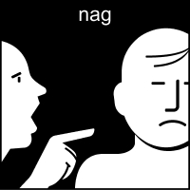
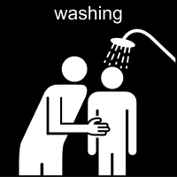

Slide 8
Tell me when it happened?

Slide 10
Who was it?

Slide 11
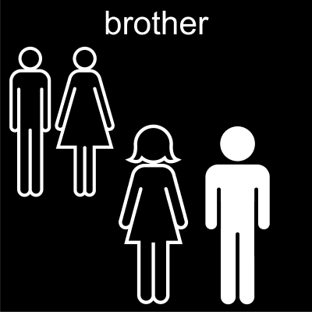
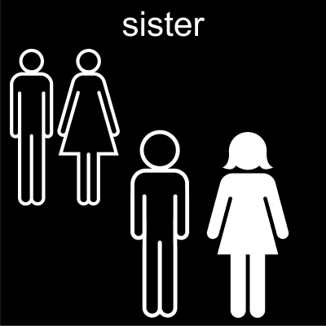

Slide 12
Where did it happen?

Slide 14
How are you feeling now?

Slide 15
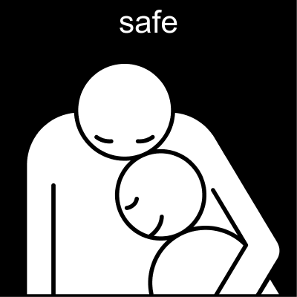
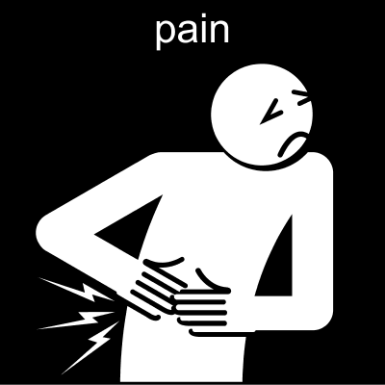

Slide 16
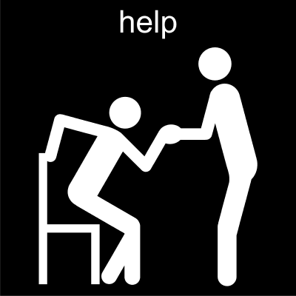
Is there anything that you want to have help with?

Slide 18
Do you want to meet and talk again?

Slide 20
Sometimes it can be difficult to talk about violence, but it is also hard to start talking about experiences of violence, whether the person has been exposed by a partner, a close relative or staff.
It can be easier to start the conversation, both as abused and as a supporter using a communication tool.
The tool Talk About Violence – ACC is a tool adapted to be used by a supporter who knows that the person she/he talks to, has experience of violence.
It may be volunteers or staff at Women Shelters or those working with support for abused people as, police officer, prosecutor, social security officers etc.
The material has been inspired by Pict-O-Stat, a survey tool developed by Neonova and the booklet What happened? developed within the framework of the project Development Center Double Exposed at Bräcke Diakoni, Gothenburg.
Good luck!

